Slide 1
Universal Design for Learning and Information Literacy Instruction
By Dr. Gigi Mohamad

Slide 2
Universal Design for Learning (UDL/I)
Multiple Means of Representation (What)
Multiple Means of Expression (How)
Multiple Means of Engagement (Why)

Slide 3
Information Literacy
Determine Information Need
Access to Needed Information
Evaluate Information Critically
Use Information Effectively
Use Information Ethically

Slide 4
Determining Information Need
Barriers
Developing insights to form research questions
Concept difficulty
Present the research in only open-ended questions
Solutions
Multiple entry points to the lesson
Group discussion
Graduated scaffolds

Slide 5
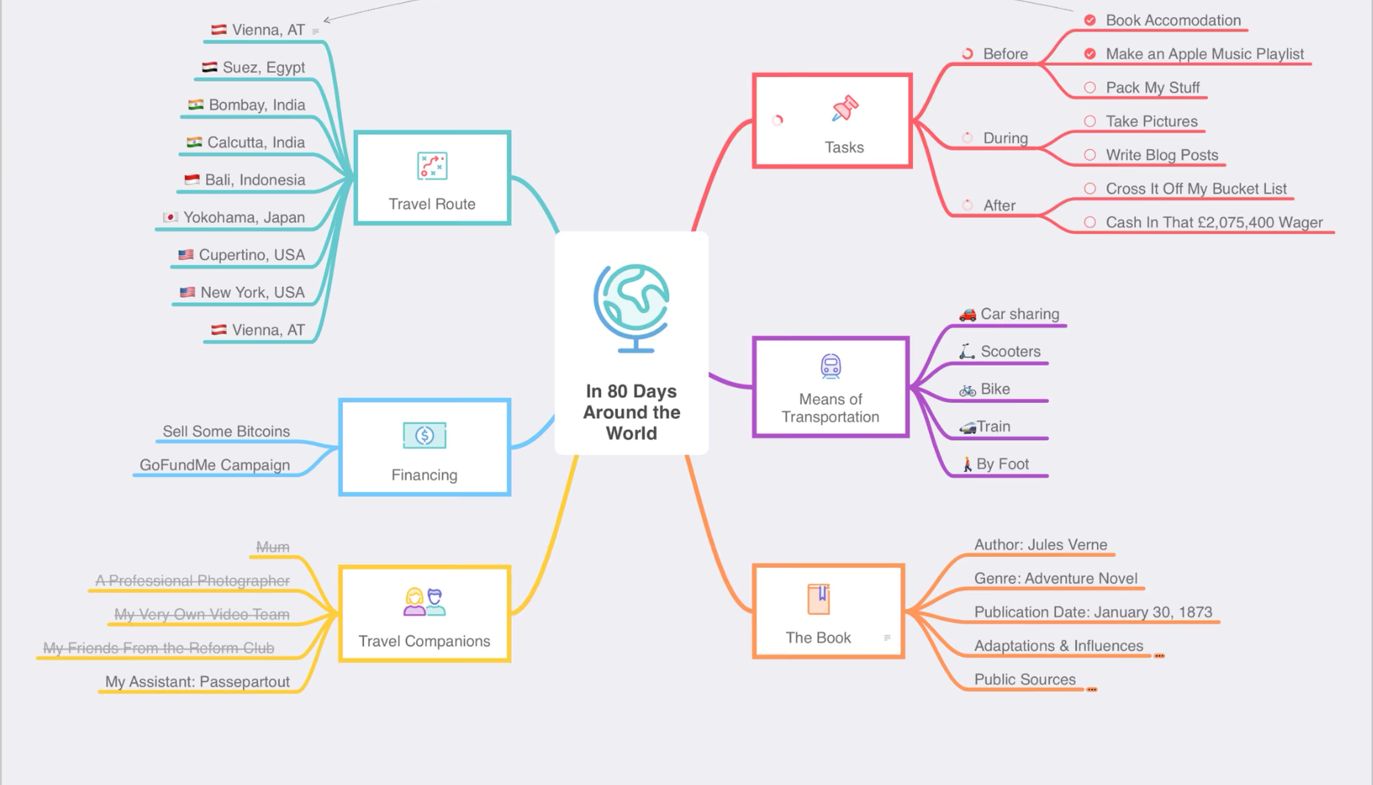
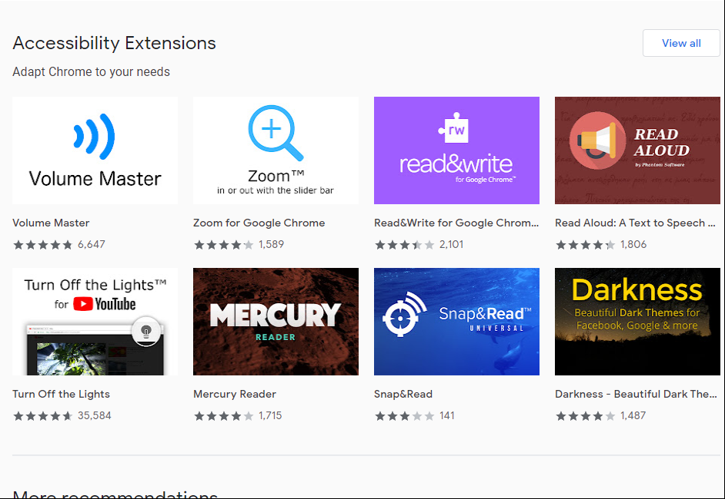
Technology Application
Organizing information
Microsoft OneNote
Mind maps (F2F and remote learning).
Chrome Accessibility Extensions

Slide 6
Access to Needed Information
Barriers
Using one format to present information
The layout and the volume of information
Solutions
Present information in more than one format
Identify critical information
Model search strategies
Use web accessibility tool

Slide 7
Technology Application
Using Databases that provide features such as dictionary, note taking, and read aloud
Also a translation feature could be helpful such as Google Translate
This Photo by Unknown Author is licensed under CC BY-SA
This Photo by Unknown Author is licensed under CC BY-SA

Slide 8
Evaluate Information Critically
Barriers
Comprehension skills
Analyzing text
Difficulty sustaining effort
Solutions
Create guides for students to self assess (such as getting started and assess my work
Support decoding of text (acronyms)
Unlock background knowledge to create intrinsic motivation

Slide 9
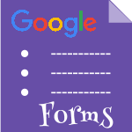
Technology Application
Google forms
Encyclopedia Britannica
This Photo by Unknown Author is licensed under CC BY-SA-NC
This Photo by Unknown Author is licensed under CC BY-SA

Slide 10
Use Information Effectively
Barriers
Organizing information
Making connections between important themes and patterns
Communication skills
Solutions
Multiple tools for communications
Set guidelines for planning and progress
Use citation-making software, print icons, and other built-in timesaving shortcuts
Decrease repetitiveness of tasks

Slide 11
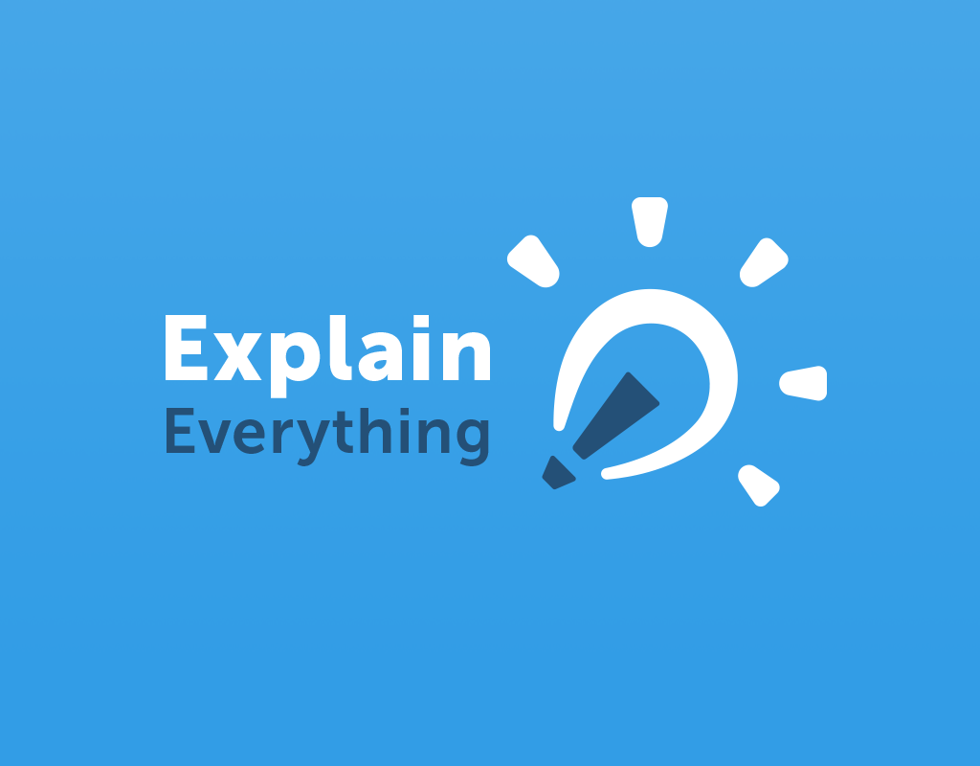
Technology Application
Microsoft OneNote
Explain Everything is an app that allow students to communicate their knowledge using images and voice recoding
This Photo by Unknown Author is licensed under CC BY-NC-ND

Slide 12
Use Information Ethically
Barriers
Processing technical terms
Prior knowledge
Solutions
Promote expectations and beliefs
Foster collaboration
Optimize value and authenticity

Slide 13
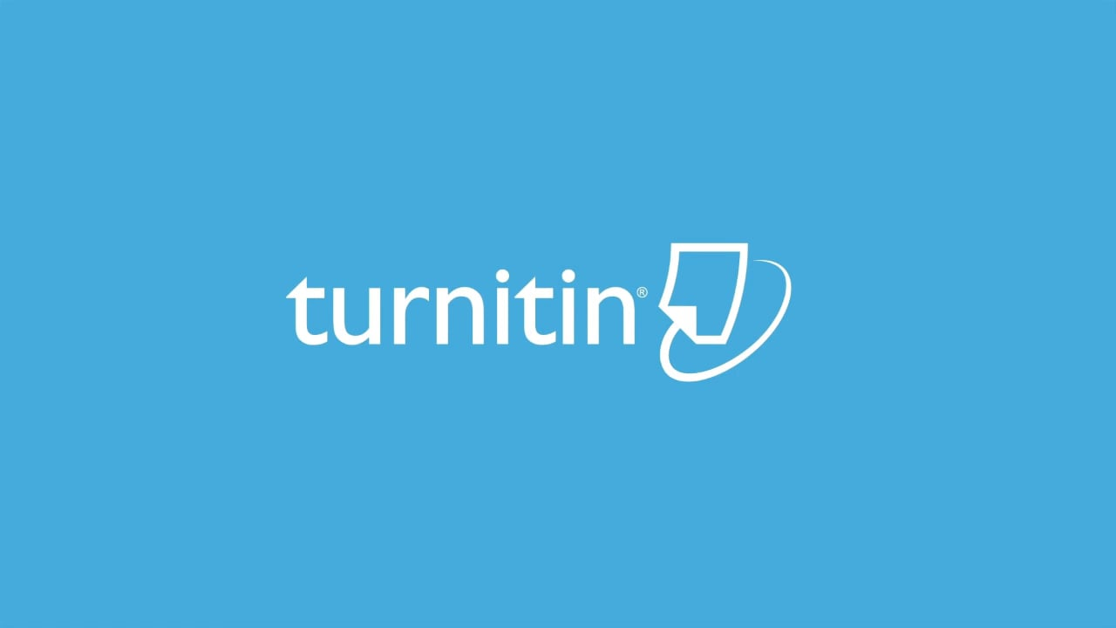
Technology Application
Citation software
Plagiarism self-check
This Photo by Unknown Author is licensed under CC BY-NC-ND
This Photo by Unknown Author is licensed under CC BY-SA-NC

Slide 14
Traditional vs. UDL Lesson Plan
Traditional Lesson Plan | UDL Lesson Plan
Focus: Research Skills (Civil war) | Focus: Research Skills (Civil war)
Materials: Textbook | Materials: Textbook (print and digital), images of artifacts with audio description, printed or digitized outline with key ideas highlighted
Instruction:9:00–9:20 Whole-group: teacher summarizes information in the textbook (section 2) 9:20–9:40 Independent work: Outline the main ideas for your paper 9:40–9:50 Independent work: start writing supporting facts for your main ideas to add to your paper and complete as homework | Instruction:9:00–9:15 Whole-group: summarize information in the textbook 9:15-–9:35 20-minute video on civil war 9:35–9:50 Small-group discussion and centers Group 1:Teacher works with a small group Group 2: Center activity—with other students Group 3: Center activity—students individually
Assessment: n/a | Assessment:: Informally assess students during whole- and small-group instruction and provide corrective feedback

Slide 15
Departing Thought
“Ability and disability are socially constructed concepts. We, as a society, decided what makes someone able and what makes someone less able. Since we created these definitions, we can also change them. The time has come to change our definition of [Dis]ability.”
Whitney Rapp (Universal Design for Learning: 100 ways to Teach all Learners)

Slide 16
Reference
Hall, T. E., Meyer, A., & Rose, D. H. (Eds.). (2012). Universal design for learning in the classroom : Practical applications. ProQuest Ebook Central https://ebookcentral.proquest.com
Nelson, L. L. (2013). Design and deliver : Planning and teaching using universal design for learning. ProQuest Ebook Central https://ebookcentral.proquest.com
Rapp, W. H. (2015). Universal design for learning in action : 100 ways to teach all learners. ProQuest Ebook Central https://ebookcentral.proquest.com
Websites
http://www.cast.org/
http://udltheorypractice.cast.org/login
https://udl-irn.org/
https://medium.com/udl-center

