Slide 1
Creative Commons at the Library
What are we already doing, and what more can we do?
Stephen Wyber, Manager, Policy and Advocacy
Victoria Owen, Board Member, IFLA

Slide 2
Libraries are…
Licensees
Publishers
Archives
Activists
Makerspaces
Content Managers
Notes:
Offer some background on how the roles of libraries are changing – this will help explain the different dimensions of how libraries and open licensing interact.
LICENSEES – as far back as 2006, libraries in the US for example were already acquiring 70% of their content via licence – i.e. online or in digital formats. This has upended the acquisition model, and introduced the situation where exceptions and limitations to copyright granted by law can be overridden by contract terms. This was the case in over 90% of licences signed by the British Library back in 2010.
PUBLISHERS – many libraries are also publishers, both of guides and learning tools, but also of scholarly texts. Library websites are clearly also copyrightable.
ARCHIVES – libraries have always played an important preservation role. From national libraries, who often have a legal responsibility to build a collection that reflects the life of the nation to local libraries who work to collect and promote local history, we are often the holders of large stores of works that are effectively owned.
ACTIVISTS – do not be fooled by the stereotype of the quiet librarian! With an understanding of the importance of information access, slow and creation, libraries are often key voices for openness, both within institutions and more publicly.
MAKERSPACES – libraries have been active in encouraging information users to become information producers. They have long worked to support students and researchers in producing work, as well as promoting creative activities in local communities. Increasingly, they are hosting makerspaces, coding clubs and 3D printing workshops.
CONTENT MANAGERS – the library and information profession has long focused on how best to manage knowledge in order to make it useful. With techniques such as text and data mining, as well as research collaboration, including across borders, growing in importance, the need for good information management is only growing stronger. Libraries have much to offer here.

Slide 3
What works? What doesn’t? What more can we do?
Notes:
As you can imagine from the previous slide, there are many ways in which the work of libraries can involve dealing with, or promoting the use of, CC and open licences. As IFLA, we are keen to look more at what is going on, and what more could happen. In short, what is working, what isn’t, and what more can we do.
The rest of this presentation offers a few case studies, but we would welcome any further views.

Slide 4
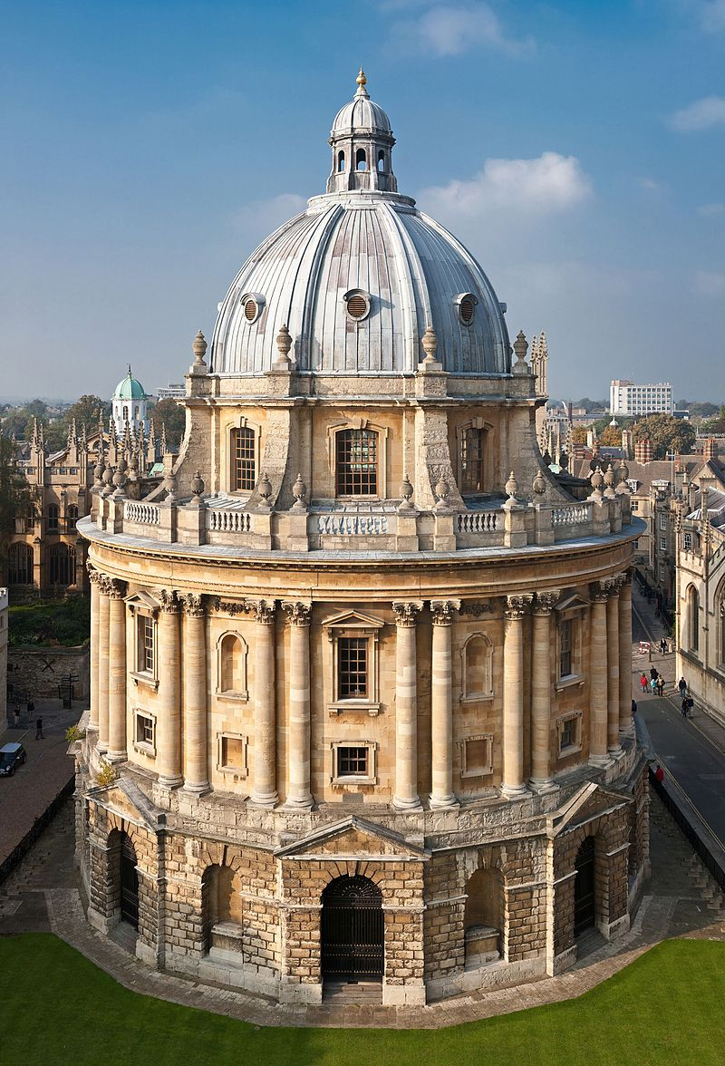
Libraries, Creative Commons, and Third Party Content
The drive for Open
How does it work in practice?
Copyright: Diliff (CC-BY 2.5), https://en.wikipedia.org/wiki/Bodleian_Library#/media/File:Radcliffe_Camera,_Oxford_-_Oct_2006.jpg
Notes:
Issues are encountered about the use of more restrictive CC licences in open publishing, such as Springer’s scientific reports: http://www.nature.com/news/researchers-opt-to-limit-uses-of-open-access-publications-1.12384. Researchers will often go for the least permissive licence, despite the consequences for future use of their works. Nonetheless, CC seems to offer a more robust framework for using literature than others, in terms of making it clear what is permissible or not.
There are also issues encountered in general about a lack of information – it is difficult to know what the licensing involves in many OA repositories, if there is any information available at all. What more can we do to promote systematic use of the right licensing information?

Slide 5
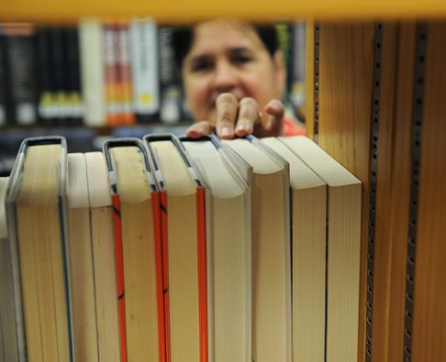
Libraries, Creative Commons, and Proprietary Content
Library learning resources
Open GLAM
© US Air Force, http://www.barksdale.af.mil/News/Article-Display/Article/635301/barksdale-library-study-haven-for-airmen/
Notes:
A first case study here can be library learning resources – factsheets and guides to students in doing their work. Survey work in California a couple of years ago showed uptake of CC licences in various places, but this was far from consistent in terms of how many materials were clearly marked, and the type of licence used: http://crln.acrl.org/content/75/7/370.full. What more can be done?
A second is how libraries are making content openly available – much of this is the work of Europeana of course! But to take one example, the British Library’s Colonial Copyright Collection was put online in 2013, giving unique access to a collection of photos from the late 19th and early 20th century https://openglam.org/2013/07/01/canada-through-a-lens-the-british-library-colonial-copyright-collection/.

Slide 6
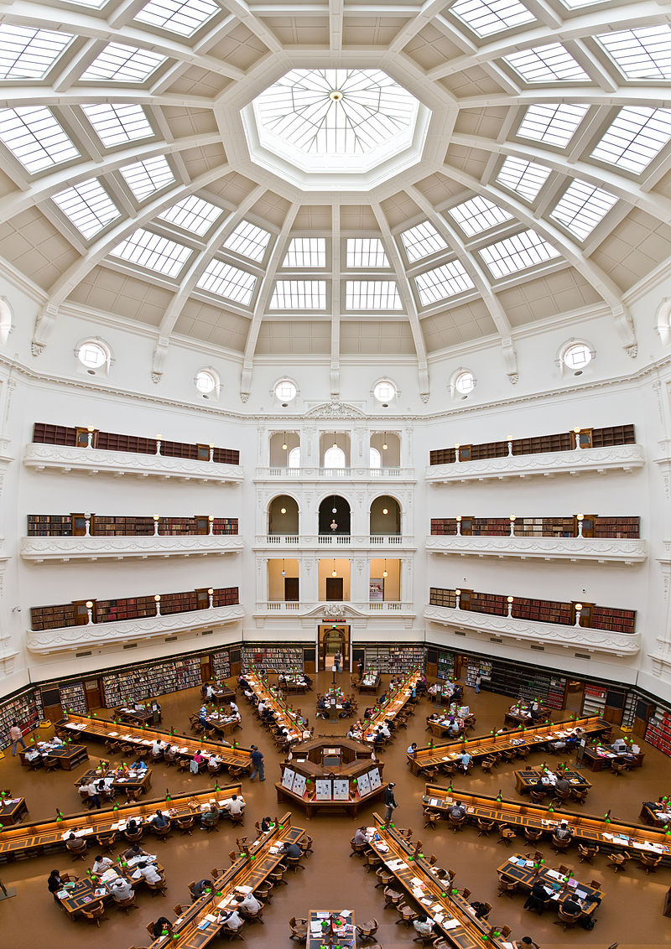
Libraries, Creative Commons, and Policy Change
Libraries as advocates for broader policy reform
Libraries as pioneers of openness within institutions
© Diliff, CC-BY 2.5 https://en.wikipedia.org/wiki/Wikipedia:The_Wikipedia_Library#/media/File:State_Library_of_Victoria_La_Trobe_Reading_room_5th_floor_view.jpg
Notes:
Libraries are clearly active in copyright discussions around the world, often taking a leading role in pushing for more exceptions and limitations in the EU, at WIPO and elsewhere.
There are also examples of situations where libraries have been at the heart of efforts to promote not only open data, but then broader open licensing policies. At the World Bank, the libraries were active internally in pushing for change. We have welcomed WIPO’s adoption of CC licences as well, and would encourage all public interest institutions to make their works available under open licences.

Slide 7
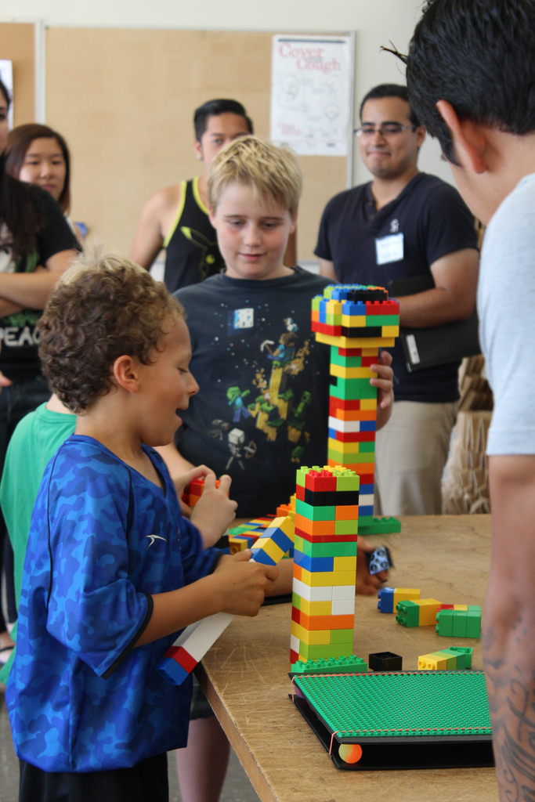
Libraries, Creative Commons, and User-Generated Content
Open licensing and increasing research impact
Co-created community archives
© San Mateo Library, CC-BY 2.5
https://www.flickr.com/photos/collegeofsanmateolibrary/15578575422
Notes:
Libraries have a major role in advising researchers on what to do with their works in order to maximise their impact. There are various guides out there, produced by offices of scholarly communications which set out the options. CC’s Certificate programme in particular provides an option that is currently being tested in US libraries.
CC also offers a means of building co-created community archives, which can cover anything from local history to current experiences and creativity. CC offers a tool for doing this, and giving a certain measure of certainty, even if no-warranty provisions mean that a CC licence cannot be a complete guarantee of what can or cannot be done with a work.

Slide 8
Libraries, Creative Commons, and Content Management
Making the most of shareable digital resources:
Islandora initiative
Notes:
See http://www.islandora.com/!

Slide 9
Ideas/Suggestions Welcome! Stephen.Wyber@ifla.org

