Slide 1
Copyright Reform in Australia 2016
IFLA World Library and Information Congress 2016
Jessica Coates - Copyright and Policy Adviser
Australian Libraries Copyright Committee
representing Australian Library and Information Association

Slide 2
Image – Mimi & Eunice by Nina Paley http://mimiandeunice.com/2011/05/23/copyright-reform/
Recent history of copyright reform in Australia
Copyright Amendment (Digital Agenda) Bill
Copyright Amendment (Moral Rights) Act
Australia-US Free Trade Agreement Implementation Act
2014 The Civil Law and Justice Legislation Amendment Bill 2014
2015 Copyright Amendment (Online Infringements) Act
2016 Copyright Amendment (Disability Access and Other Measures) Bill [we hope]
2017 Fair use?

Slide 3
Copyright Amendment (Disability Access and Other Measures) Bill

Slide 4
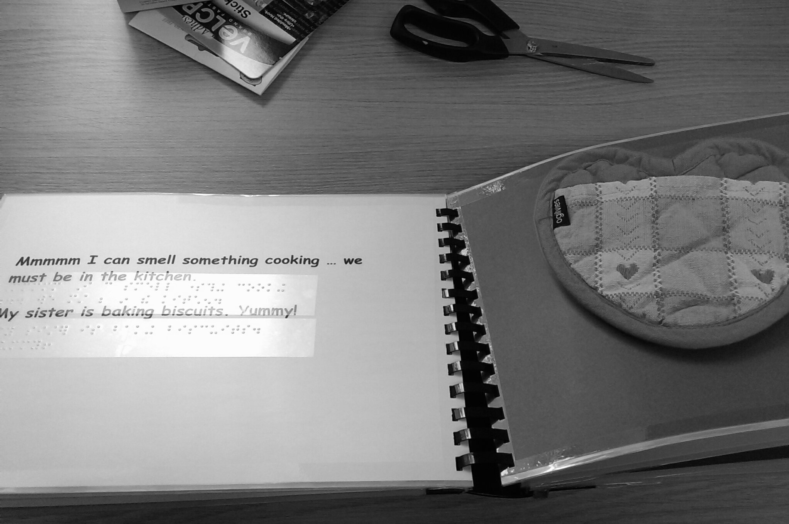
Marrakesh Treaty
Gov says we don’t have to make changes
But making changes anyway
And while we’re at it…

Slide 5
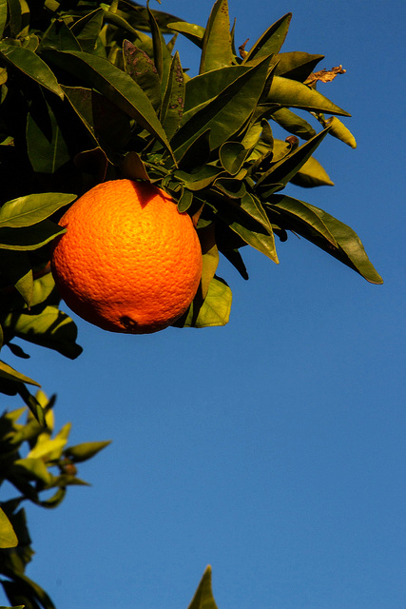
low hanging fruit
Sunrise Orangr by Don McCollough, CC BY http://www.flickr.com/photos/69214385@N04/8509517971/in/photostream/
Disability – new fair dealing and broader institution exception (removes record keeping)
Preservation – fixes current confusing preservation exceptions & removes (almost) all restrictions
Safe harbours – extends ISP protection to other online providers (including libraries & archives)
Unpublished works - ends perpetual copyright, replaces with life plus 70 or 70 from creation for orphan works
Education – simplifies statutory licence & allows online exams

Slide 6
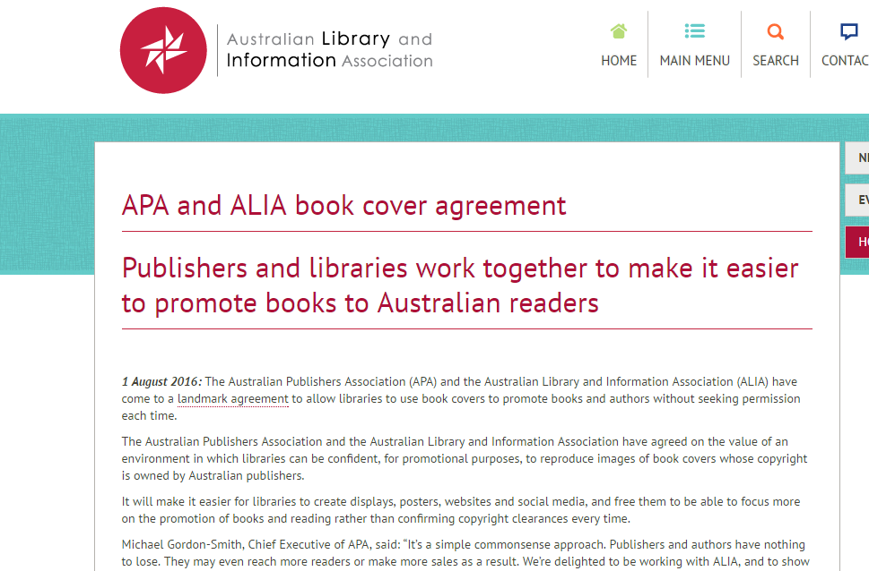

Slide 7
Prospects?
Only at exposure draft stage
Got caught behind more controversial legislation and election
Government has committed to table at start of new parliament
We are pushing for tabling in time for Marrakesh coming into force 30 September
Mainly bi-partisan so should get through … if it ever gets tabled

Slide 8
Fair Use

Slide 9
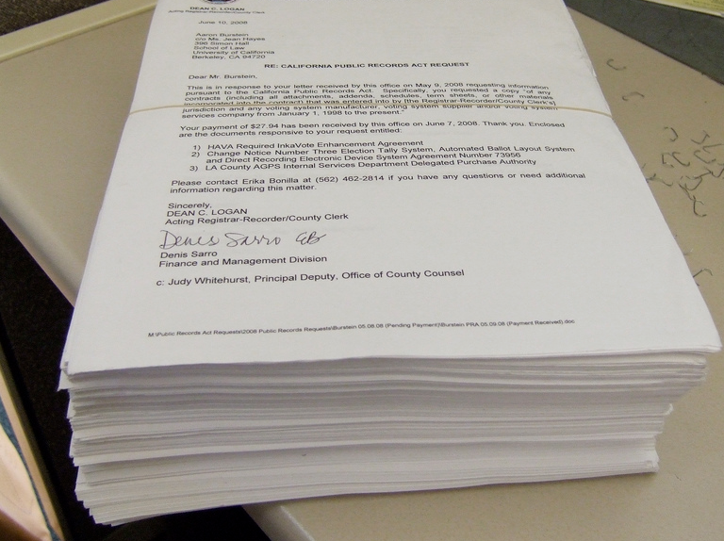
Australian Copyright Act = great example of why fair use (or at least principle based exception) is needed:
700 pages long
41 minor amendments since 1996
Most exceptions complex - 1.5+ pages long
eg s44BA Acts done in relation to certain medicine
OMGWTF... weighing in at 800 lbs. ... By joebeone, http://www.flickr.com/photos/joebeone/2585191273/

Slide 10
Why do libraries want fair use?
Increases flexibility, acts as a safety valve
More intuitive for lay person
Removes confusion caused by complex exceptions
Gives institutions confidence to be innovative
Empower clients, not just institutions
Only way to have a future-proofed copyright system

Slide 11
Image – Mimi & Eunice by Nina Paley http://mimiandeunice.com/2011/07/29/fair-use//
History of fair use recommendations in Australia
1998 CLRC Simplification Report
Joint Standing Committee on Treaties AUSFTA Report
Senate Selection Committee on AUSFTA
Australia-US Free Trade Agreement Implementation Act
2013 House of Reps Standing Committee on Infrastructure – IT Pricing Report
2014 ALRC Copyright and the Digital Economy
2016 Productivity Commission IP Framework (April draft – final due Sept)

Slide 12
Productivity Commission draft
Found copyright was weighted towards right holders
Recommended fair use for balance
Controversial - statements about term, allowing parallel importation for books
Non-controversial - end geoblocking, end perpetual copyright, mandate open access
Vocal campaign by publishers and authors against the report

Slide 13
Prospects?
New Prime Minister pro technology and anti-red tape
Government has innovation agenda
Closer than we’ve ever been
BUT…
Still extremely strong opposition
Rights holders pushing for small tweaks
Fundamental change? Only time will tell

Slide 14
Thanks
All original material in this presentation, and the presentation as a whole, are licensed under a Creative Commons Attribution 4.0 licence. Feel free to reproduce, share and adapt the material, attributing Jessica Coates as the original author.

